Slide 1
INVESTMENT ASSIGNMENT SUBMISSION
Name: Harish Kumar

Slide 2
Spark Funds Investment Analysis
The Spark Funds, an asset management company wants to make investment in a few companies. The CEO of Sparks Funds wants to understand the global trends in investment so that she can take the investment decision effectively. Since Spark Funds is in early stage start-up investment company, they want to invent where most “other investors are investing” strategy.
However, Spart Funds has two minor constraints for investments:
It wants to invest between 5 to 15 million USD per round of investment
It wants to invest only in English-speaking countries
Problem Statement or Business Objective:
Identify the best sectors, among the English-speaking countries, and a suitable investment type among venture, angel, seed, and private equity to invest 5 to 15 million USD per round of investment for making investment. The overall strategy is to invest where others are investing, implying that the 'best' sectors and countries are the ones 'where most investors are investing'.

Slide 3
Solution Approach
Investment type analysis
Comparing the typical investment amounts in the venture, seed, angel, private equity etc
So that Spark Funds can choose the type that is best suited for their strategy
Country analysis
Identifying the countries which have been the most heavily invested in the past. These will be Spark Funds’ favorites as well.
Sector analysis
Understanding the distribution of investments across the eight main sectors
Data Sourcing
Real investment data from crunchbase.com
English Speaking Countries List from Wiki
Data Cleaning
Analysis the data and clear/process the Null data
Merge the table variable files and create master frame

Slide 4
Funding Type Analysis
The funding types such as seed, venture, angel, etc. depend on the type of the company (startup, corporate, etc.), its stage (early-stage startup, funded startup, etc.), the amount of funding (a few million USD to a billion USD), and so on. For example, seed, angel and venture are three common stages of startup funding.
Seed/angel funding refer to early-stage startups whereas venture funding occurs after seed or angel stage/s and involves a relatively higher amount of investment.
Private equity type investments are associated with much larger companies and involve much higher investments than venture type. Startups which have grown in scale may also receive private equity funding. This means that if a company has reached the venture stage, it would have already passed through the angel or seed stage/s.
Since Spark Funds are interest in early-stage start-up, we must analyse the venture, angel, seed, and private equity funding types to find most representative investment considering that Spark Funds wants to invest 5 to 15 millons USD
Result: The most suited Funding Type for Spark Fund is “Venture”
Funding Type | Most Representative Investment
Angle | 400,000
Private Equity | 20,000,000
Seed | 275,000
Venture | 5,000,000

Slide 5
Country Analysis
Country | Total Raised Amount in USD in Venture Fund Type
USA | 422,510,842,796.00
CHN | 39,835,418,773.00
GBR | 20,245,627,416.00
IND | 14,391,858,718.00
CAN | 9,583,332,317.00
FRA | 7,259,536,732.00
ISR | 6,907,514,579.00
DEU | 6,346,959,822.00
JPN | 3,363,676,611.00
Spark Funds wants to invest in countries with the highest amount of funding for Venture investment type. This is a part of its broader strategy to invest where most investments are occurring.
Spark Funds wants to see the top nine countries which have received the highest total funding
For the chosen investment type, make a data frame named top9 with the top nine countries (based on the total investment amount each country has received)

Slide 6
Sector Analysis
United Sates - USA
Main_Sector | Sum of Raised Amount | Count of Raised Amount
Others | 26089280296 | 2923
Cleantech / Semiconductors | 21181003033 | 2297
Social, Finance, Analytics, Advertising | 16680695048 | 1912
Form the Sort listed Countries, find the top 3 Sectors
United Kingdom - GBR
Main_Sector | Sum of Raised Amount | Count of Raised Amount
Others | 1249124289 | 143
Cleantech / Semiconductors | 1136905008 | 127
Social, Finance, Analytics, Advertising | 821888357 | 98
INDIA - IND
Main_Sector | Sum of Raised Amount | Count of Raised Amount
Others | 1249124289 | 143
Cleantech / Semiconductors | 1136905008 | 127
Social, Finance, Analytics, Advertising | 821888357 | 98

Slide 7
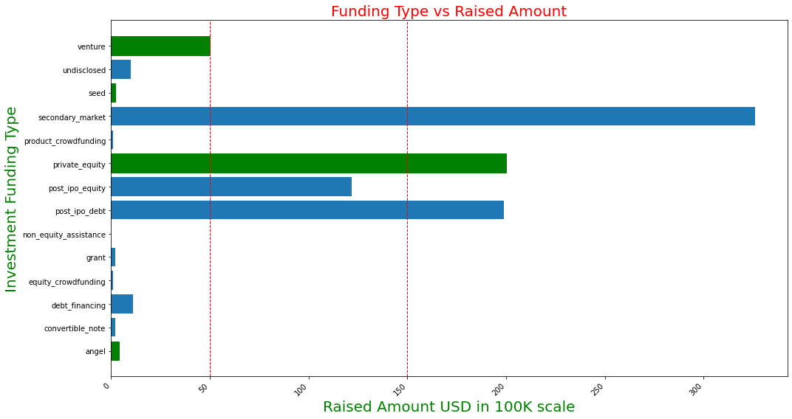
Best Funding Type

Slide 8
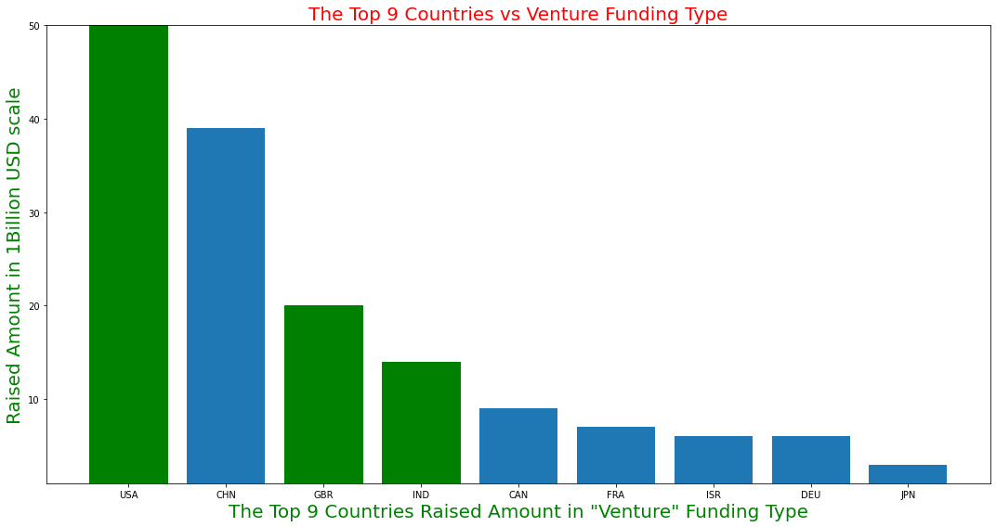
Top 9 Countries

Slide 9
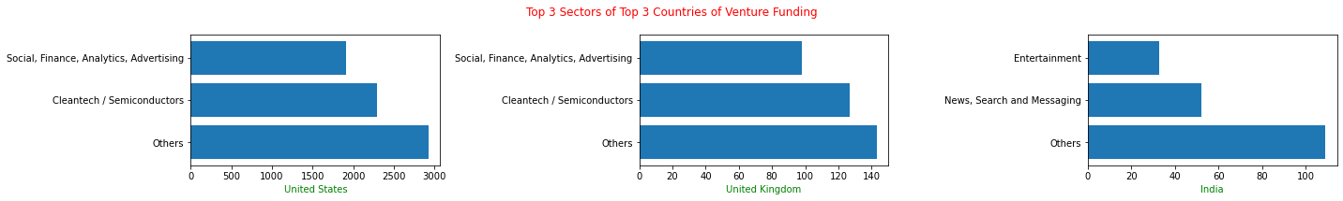
Top 3 Sectors by Countries

Slide 10
Conclusion
Analysis | Result
Best Sector to Invest | Venture
Best Country to Invest | United States -USA, United Kingdom – GBR, India - IND
Best Sector to Invest | It is various based on the Countries. Refer the below table for country wise analysis result
Analysis by top 3 Countries | USA - United States | GBR - United Kingdom | IND - INDIA
1. Total number of investments (count) | 11235 | 584 | 301
2. Total amount of investment (USD) | 100,426,287,841.00 | 5,086,469,206.00 | 2,710,537,552.00
3. Top sector (based on count of investments) | Others | Others | Others
4. Second-best sector (based on count of investments) | Cleantech / Semiconductors | Cleantech / Semiconductors | News, Search and Messaging
5. Third-best sector (based on count of investments) | News, Search and Messaging | News, Search and Messaging | Entertainment
6. Number of investments in the top sector (refer to point 3) | 2923 | 143 | 109
7. Number of investments in the second-best sector (refer to point 4) | 2297 | 127 | 52
8. Number of investments in the third-best sector (refer to point 5) | 1563 | 73 | 33
9. For the top sector count-wise (point 3), which company received the highest investment? | virtustream | electric-cloud | firstcry-com
10. For the second-best sector count-wise (point 4), which company received the highest investment? | biodesix | eusa-pharma | gupshup-technology-india-pvt-ltd

